Slide 1
Chapter 6
Introduction to Inference
Lecture Slides
Introduction to the Practice of Statistics
Tenth Edition
David S. Moore George P. McCabe
Bruce Craig

Slide 2
Chapter 6
Introduction to Inference
6.1 Estimating with Confidence
6.2 Tests of Significance
6.3 Use and Abuse of Tests
6.4 Power and Inference as a Decision

Slide 3
6.1 Estimating with Confidence
Overview of Inference
Statistical confidence
Confidence intervals
Confidence interval for a population mean
How confidence intervals behave
Choosing the sample size
Some cautions

Slide 4
Statistical Inference 1
After we have selected a sample, we know the responses of the individuals in the sample. However, the reason for taking the sample is to infer from those data some conclusion about the wider population represented by the sample.
Statistical inference provides methods for drawing conclusions about a population from sample data.
Population
Sample
Collect data from a representative sample...
Make an inference about the population.

Slide 5
Overview of Inference
Statistical Inference involves two prominent techniques
Confidence Intervals
Hypothesis Tests
In both techniques, we ask:
“What would happen if we used the method many times?”
Formal statistical inference is based on sampling distributions, so we must understand the language of probability and the logic of the reasoning.
When you see statistical inference, you should act as if your data come from a random sample or a randomized experiment.

Slide 6
Simple Conditions for Inference about a Mean
This chapter presents the basic reasoning of statistical inference. We start with a setting that is too simple to be realistic.
Simple Conditions for Inference about a Mean
We have an SRS from the population of interest. There is no nonresponse or other practical difficulty.
The variable we measure has an exactly Normal distribution N(μ, σ) in the population.
We do not know the population mean μ, but we do know the population standard deviation σ.
Note: The conditions that we have a perfect SRS, that the population is exactly Normal, and that we know the population standard deviation are all unrealistic.

Slide 7
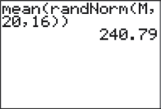
Statistical Estimation 1
Suppose your instructor has selected a “mystery mean” value µ and stored it as “M” in his or her calculator. The following command was executed on the calculator: mean(randNorm(M,20,16))
The result was 240.79.
This tells us the calculator chose an SRS of 16 observations from a Normal population with mean M and standard deviation 20. The resulting sample mean of those 16 values was 240.79.
We want to determine an interval of reasonable values for the population mean µ. We can use the result above and what we learned about sampling distributions in the previous chapters.

Slide 8
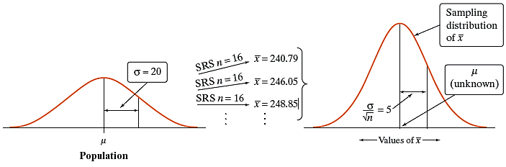
Statistical Estimation 2
Because the sample mean is 240.79, we could guess that µ is “somewhere” around 240.79.
How close to 240.79 is µ likely to be?
To answer this question, we must ask another:

Slide 9
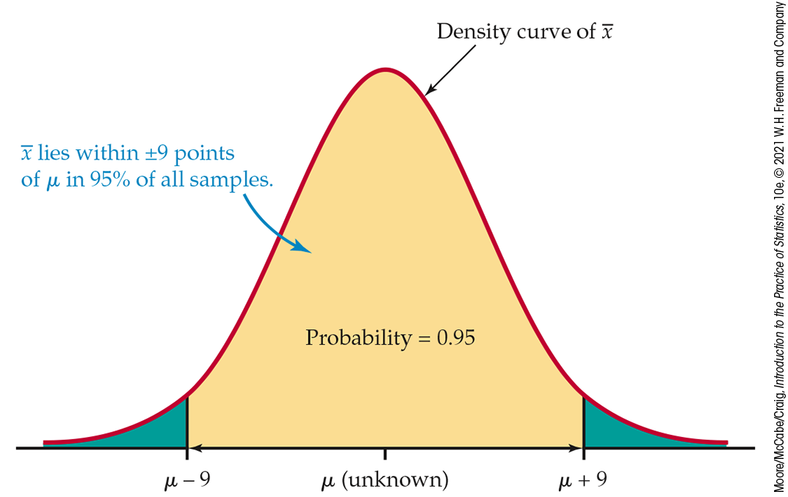
Statistical Estimation 3
In repeated samples, the values of the sample mean will follow a Normal distribution with mean µ and standard deviation 5.
The 68-95-99.7 rule tells us that in 95% of all samples of size 16, the sample mean will be within 10 points (2 standard deviations) of µ.
If the sample mean is within 10 points of µ, then µ is within 10 points of the sample mean.
Therefore, the interval from 10 points below to 10 points above the sample mean will “capture” µ in about 95% of all samples of size 16.
If we estimate that µ lies somewhere in the interval 230.79 to 250.79, we are using a method that captures the true µ in about 95% of all possible samples of this size.

Slide 10
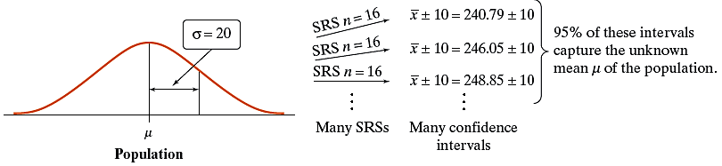
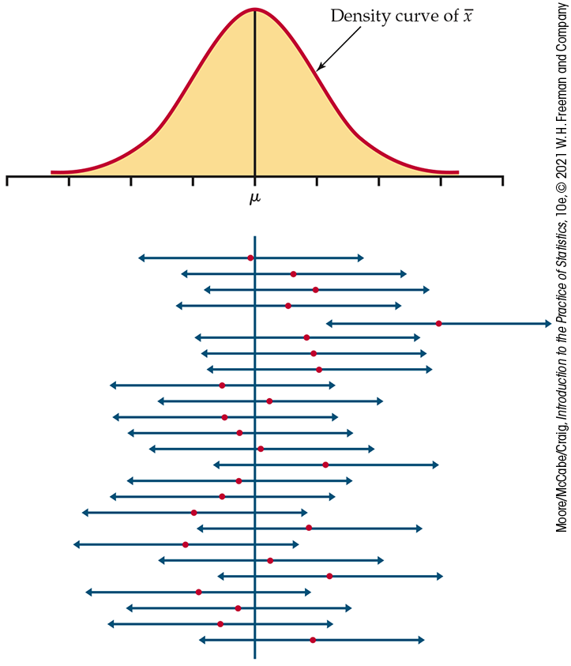
Statistical Confidence
The confidence level, or C, is the overall capture rate if the method is used many times. The sample mean will vary from sample to sample, but when we use the method “estimate ± margin of error’’ to get each interval, C × 100% of all intervals capture the unknown population mean µ. (Note: By convention, C will be expressed as a decimal, so it will always be between 0 and 1.)
Interpreting a Confidence Level
To say that we are 95% confident means:
“95% of all possible samples of a given size from this population will yield intervals that capture the unknown parameter.”

Slide 11
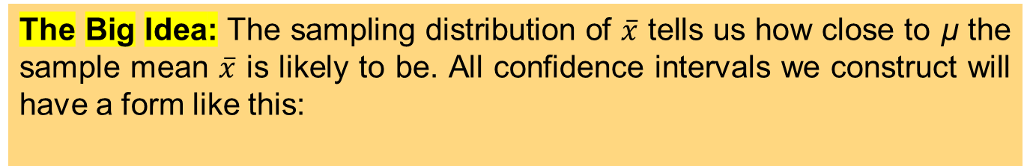
Confidence Interval
The Big Idea: The sampling distribution of $\overline{x}$ tells us how close to µ the sample mean $\overline{x}$ is likely to be. All confidence intervals we construct will have a form like this:
estimate ± margin of error
A level C confidence interval for a parameter has two parts:
An interval calculated from the data, which has the form
estimate ± margin of error
A confidence level C, where C is the probability that the interval will capture the true parameter value in repeated samples. That is, the confidence level is the success rate for the method.
Note: It is typical to choose a confidence level of 90% or higher because we want to be quite sure of our conclusions. The most common confidence level is 95%.

Slide 12
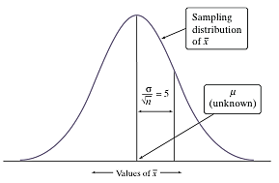
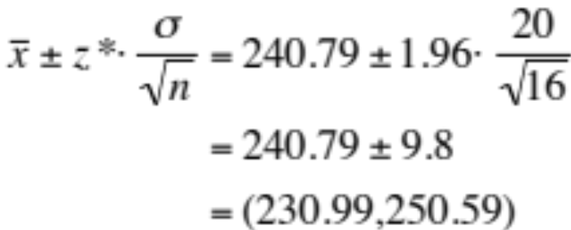
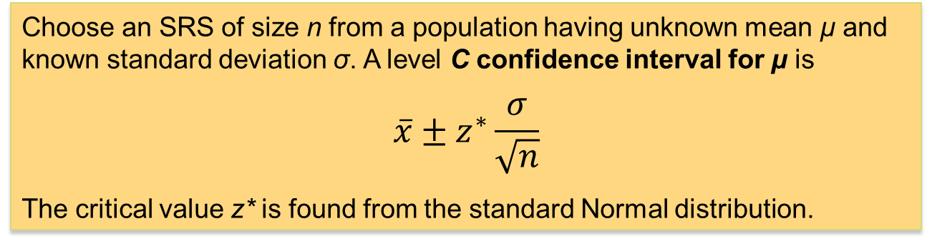
Confidence Interval for a Population Mean
Previously, we estimated the “mystery mean” µ by constructing a confidence interval using the sample mean = 240.79.
To calculate a 95% confidence interval for µ, we use the following formula:
estimate ± (critical value) • (standard deviation of statistic)
Confidence Interval for the Mean of a Normal Population
Choose an SRS of size n from a population having unknown mean µ and known standard deviation σ. A level C confidence interval for µ is
$$\overline{x}±z^{∗}\frac{σ}{\sqrt{n}}$$
The critical value z* is found from the standard Normal distribution.

Slide 13

Finding Specific z*-Values
We can use a table of z/t-values (Table D). For a particular confidence level, C, the appropriate z*-value is just above it.
Example: For a 98% confidence level, z* = 2.326.
We can also use software. In Excel,
=NORMINV(probability,mean,standard_dev)
gives z for a given cumulative probability.
Because we want the middle C × 100%, the probability we require is (1 – C)/2.
Example: For a 98% confidence level, =NORMINV(.01,0,1) = −2.32635.

Slide 14
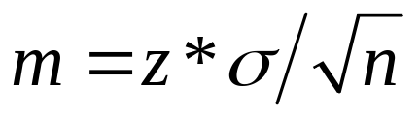
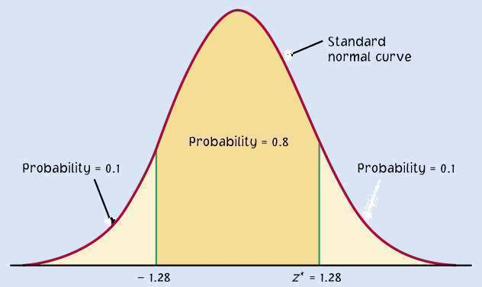
The Margin of Error
The confidence level C determines the value of z* (in Table D).
The margin of error also depends on z*.
Higher confidence C implies a larger margin of error m and, therefore, less precision in our estimates).
A lower confidence level C produces a smaller margin of error m (and thus better precision in our estimates).
C
m m
−z*
z*

Slide 15
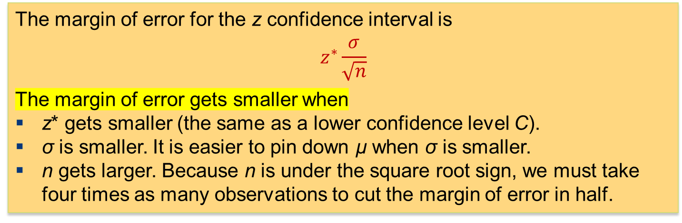
How Confidence Intervals Behave
The z confidence interval for the mean of a Normal population illustrates several important properties that are shared by all confidence intervals in common use.
The user chooses the confidence level, and the margin of error follows.
We would like high confidence and a small margin of error.
  High confidence suggests that our method almost always gives correct answers.
  A small margin of error suggests that we have pinned down the parameter precisely.
The margin of error for the z confidence interval is
$$z^{∗}\frac{σ}{\sqrt{n}}$$
The margin of error gets smaller when
z* gets smaller (the same as a lower confidence level C).
σ is smaller. It is easier to pin down µ when σ is smaller.
n gets larger. Because n is under the square root sign, we must take four times as many observations to cut the margin of error in half.

Slide 16

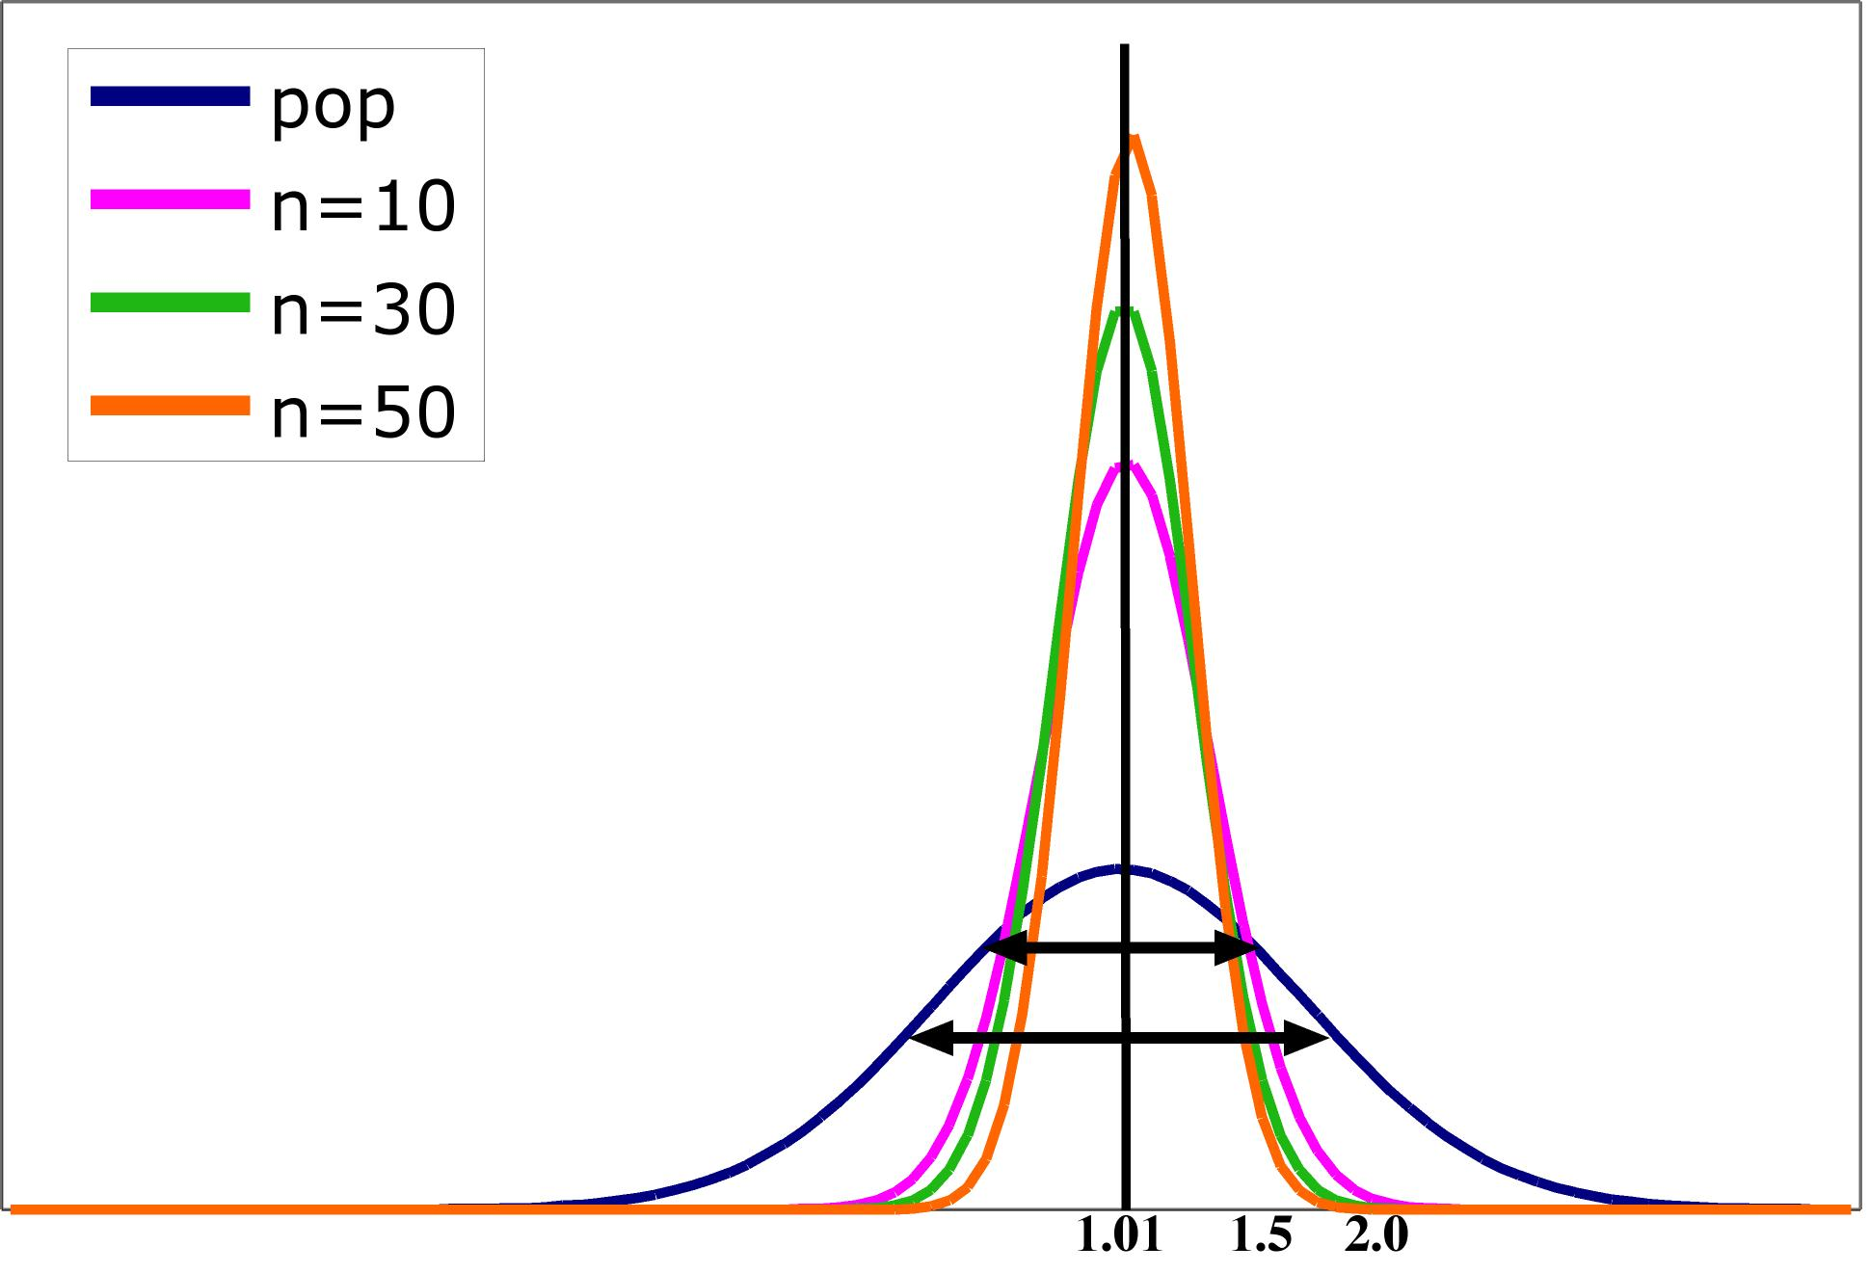
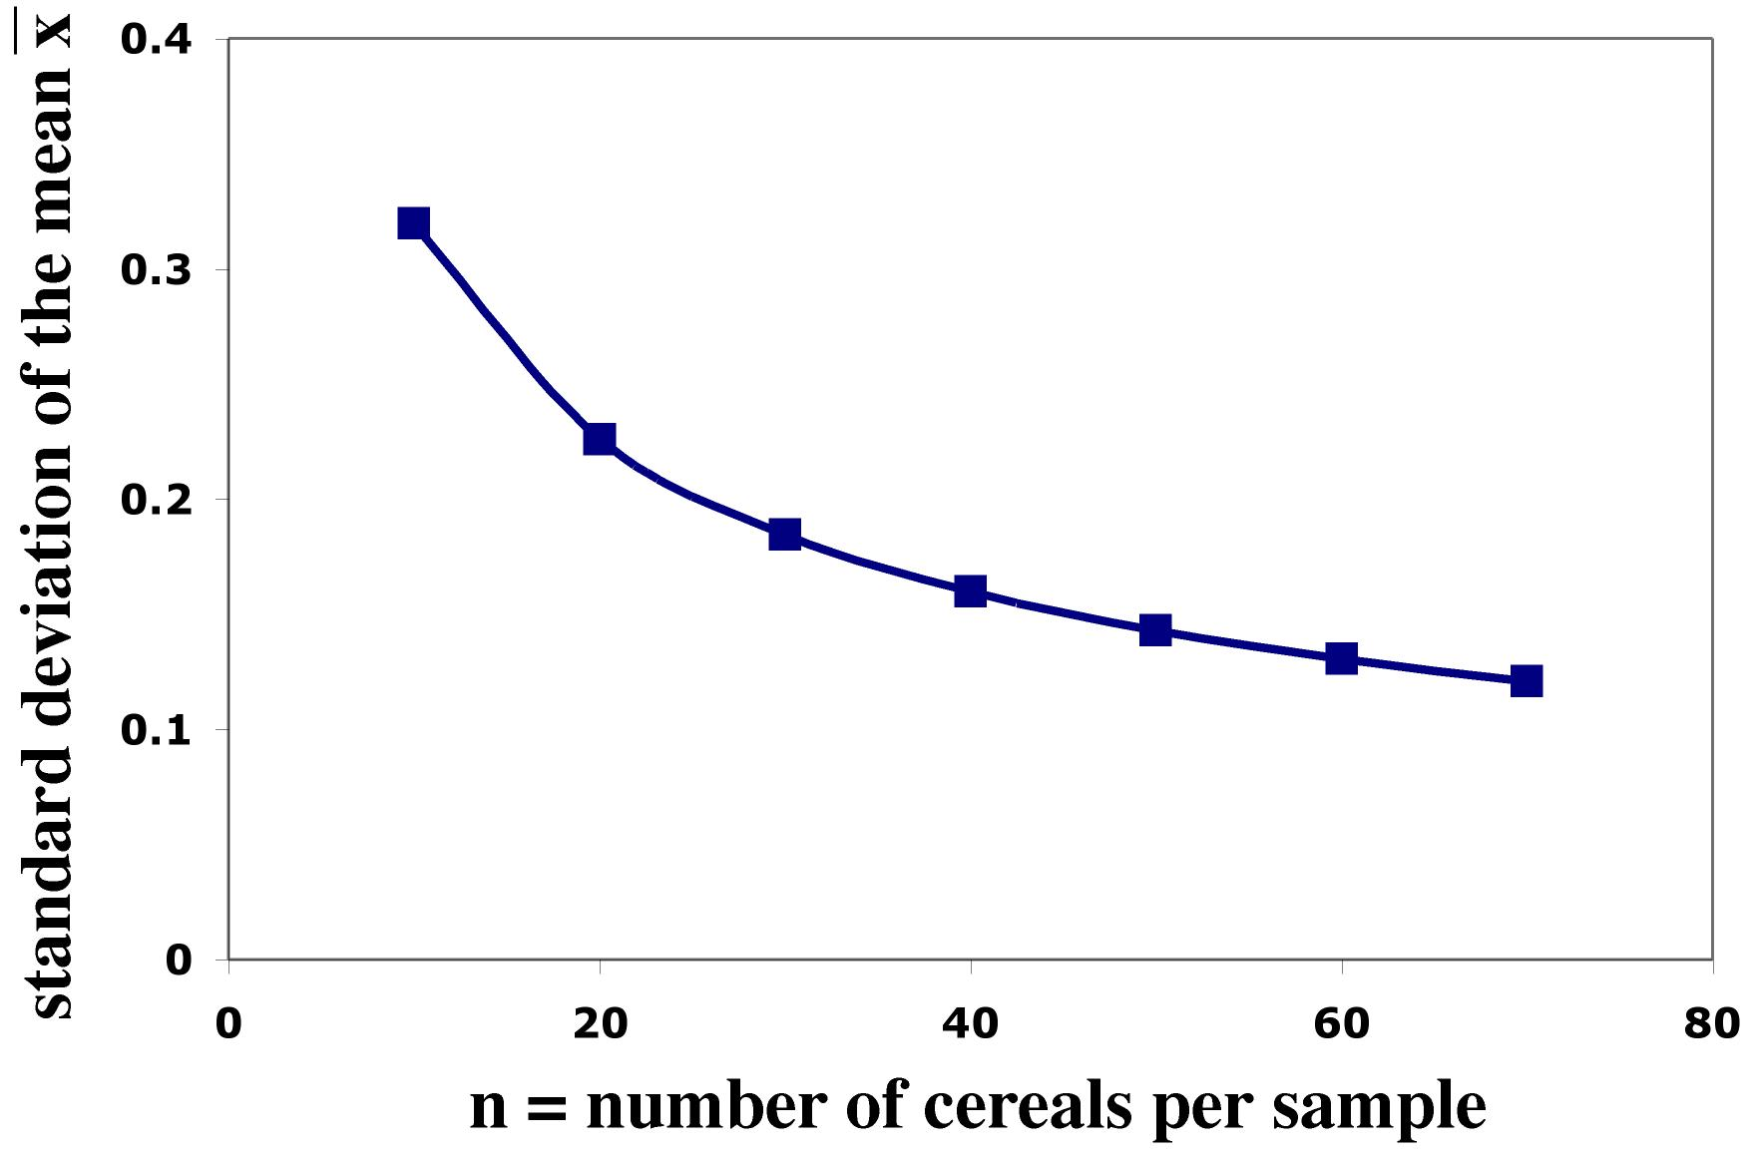
Impact of Sample Size
The spread in the sampling distribution of the mean is a function of the number of individuals per sample.
  The larger the sample size, the smaller the standard deviation (spread) of the sample mean distribution.
  The spread decreases at a rate equal to .
Standard error σ ⁄ √n
Sample size n

Slide 17
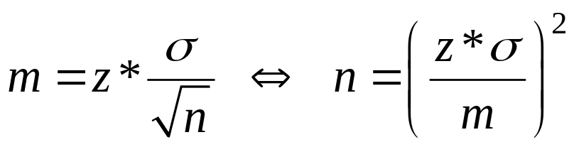
Choosing the Sample Size
You may need a certain margin of error (e.g., in drug trials or manufacturing specs). In most cases, we have no control over the population variability (σ), but we can choose the number of measurements (n).
The confidence interval for a population mean will have a specified margin of error m when the sample size is
Note: Remember, though, that sample size is not always stretchable at will.
There are typically costs and constraints associated with large samples. The best approach is to use the smallest sample size that can give you useful results.

Slide 18
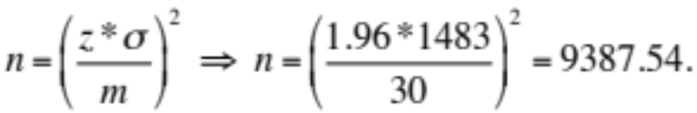
Sample Size
Example: How many undergraduates should we survey?
Suppose we are planning a survey about college savings programs. We want the margin of error of the amount contributed to be $30 with 95% confidence. Let us assume the population standard deviation, σ, equals $1483.
How many measurements should we take?
For a 95% confidence interval, z* = 1.96.
Using only 9387 measurements will not be enough to ensure that m is no more than $30. Therefore, we need at least 9388 measurements.

Slide 19
Some Cautions
The data should be an SRS from the population.
The formulas for confidence interval and sample size are not correct for other sampling methods.
Inference cannot rescue badly produced data.
Confidence intervals are not resistant to outliers.
If n is small (<15) and the population is not Normal, the true confidence level will be different from C.
The standard deviation σ of the population must be known.
The margin of error in a confidence interval covers only random sampling errors!

Slide 20
6.2 Tests of Significance
The reasoning of significance tests
Stating hypotheses
Test statistics
P-values
Statistical significance
Tests for a population mean
Two-sided significance tests and confidence intervals

Slide 21
Statistical Inference 2
Confidence intervals are one of the two most common types of statistical inference. Use a confidence interval when your goal is to estimate a population parameter.
The second common type of inference, called tests of significance, has a different goal: to assess evidence in the data about some claim concerning a population.
A test of significance is a formal procedure for comparing observed data with a claim (also called a hypothesis) the truth of which we want to assess.
The claim is a statement about a parameter such as the population proportion p or the population mean µ.
We express the results of a significance test in terms of a probability, called the P-value, that measures how well the data and the claim agree.

Slide 22
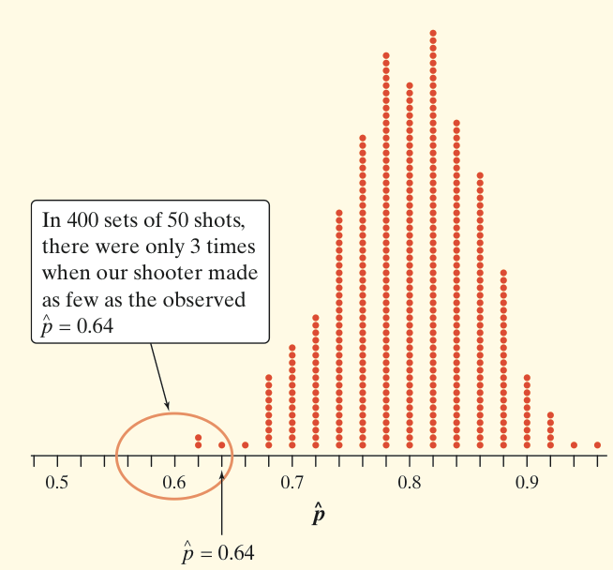
The Reasoning of Tests of Significance
Example: Suppose a basketball player claimed to be an 80% free-throw shooter. To test this claim, we have him attempt 50 free throws. He makes 32 of them. His sample proportion of made shots is 32/50 = 0.64.
What can we conclude about the claim based on these sample data?
We can use software to simulate 400 sets of 50 shots each on the assumption that the player is an 80% free-throw shooter.
We can say how strong the evidence against the player’s claim is by giving the probability that he would make as few as 32 out of 50 free throws if he really makes 80% in the long run.
Assuming that the actual parameter value is p = 0.80, the observed statistic is so unlikely that it gives convincing evidence that the player’s claim is not true.

Slide 23
Stating Hypotheses (1 of 2)
A significance test starts with a careful statement of the claims we want to compare.
The claim tested by a statistical test is called the null hypothesis (H₀). The test is designed to assess the strength of the evidence against the null hypothesis. Often, the null hypothesis is a statement of “no effect” or “no difference in the true means.”
The claim about the population for which we’re trying to find evidence is the alternative hypothesis (H_{a}). The alternative is one-sided if it states either that a parameter is larger than the null hypothesis value or that it is smaller than the null hypothesis value. It is two-sided if it states that the parameter is different from the null value.
In the free-throw shooter example, let p be the true long-run proportion of made free throws, and suppose our hypotheses are
H₀: p = 0.80 H_{a}: p < 0.80
Here, H_{a} is a one-sided alternative.

Slide 24
Stating Hypotheses (2 of 2)
Example: Does the job satisfaction of assembly-line workers differ when their work is machine-paced rather than self-paced? One study chose 18 subjects at random from a company with over 200 workers who assembled electronic devices. Half of the workers were assigned at random to each of two groups. Both groups did similar assembly work, but one group could pace itself, while the other group used an assembly line that moved at a fixed pace. After two weeks, all the workers took a test of job satisfaction. Then they switched work setups and took the test again after two more weeks. The response variable is the difference in satisfaction scores, self-paced minus machine-paced.
The parameter of interest is the mean µ of the differences (self-paced minus machine-paced) in job satisfaction scores in the population of all assembly-line workers at this company.
State appropriate hypotheses for performing a significance test.
Because the initial question asked whether the two groups differ in job satisfaction, the alternative hypothesis is two-sided; either µ < 0 or µ > 0. For simplicity, we write this as µ ≠ 0. That is,
H₀: µ = 0
H_{a}: µ ≠ 0

Slide 25
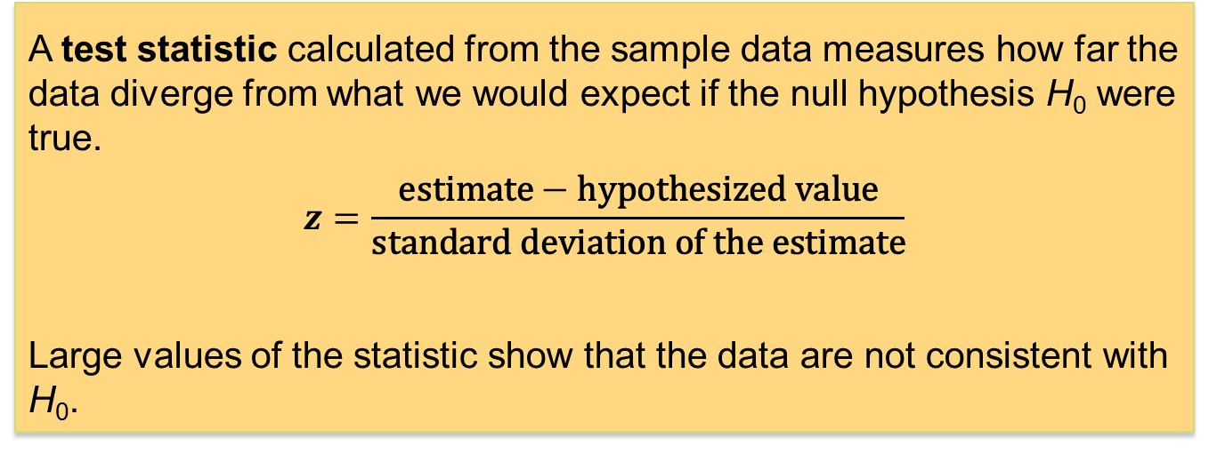
Test Statistic
A test of significance is based on a statistic that estimates the parameter that appears in the hypotheses. When H₀ is true, we expect the estimate to be near the parameter value specified in H₀.
Values of the estimate far from the parameter value specified by H₀ give evidence against H₀.
A test statistic calculated from the sample data measures how far the data diverge from what we would expect if the null hypothesis H₀ were true.
$$z=\frac{\text{estimate}−\text{hypothesized} \text{value}}{\text{standard} \text{deviation} \text{of} \text{the} \text{estimate}}$$
Large values of the statistic show that the data are not consistent with H₀.

Slide 26
P-Value
The null hypothesis H₀ states the claim we seek to disprove.
The probability that measures the strength of the evidence against a null hypothesis is called a P-value.
The probability, computed assuming H₀ is true, that the statistic would take a value as extreme as or more extreme than the one observed is called the P-value of the test.
The smaller the P-value, the stronger the evidence against H₀.
Small P-values are evidence against H₀ because they say that the observed result is unlikely to occur when H₀ is true.
Large P-values fail to give convincing evidence against H₀ because they say that the observed result is likely to occur by chance when H₀ is true.

Slide 27
Statistical Significance 1
The final step in performing a significance test is to draw a conclusion about the competing claims you were testing. We will make one of two decisions based on the strength of the evidence against the null hypothesis (and in favor of the alternative hypothesis)―reject H₀ or fail to reject H₀.
  If our sample result is too unlikely to have happened by chance assuming H₀ is true, then we will reject H₀.
  Otherwise, we will fail to reject H₀.
Note: A fail-to-reject-H₀ decision in a significance test does not mean that H₀ is true. For that reason, you should never “accept H₀” or use language implying that you believe H₀ is true.
In a nutshell, our conclusion in a significance test comes down to this:
P-value small → reject H₀ → conclude H_{a} (in context),
P-value large → fail to reject H₀ → cannot conclude H_{a} (in context).

Slide 28
Statistical Significance 2
There is no ironclad rule for how small a P-value should be in order for us to reject H₀—it is a matter of judgment and depends on the specific circumstances. But we can compare the P-value with a fixed value that we regard as decisive, called the significance level. We write it as α, the Greek letter alpha. When our P-value is less than the chosen α, we say that the result is statistically significant.
If the P-value is smaller than α, we say that the data are statistically significant at level α. The quantity α is called the significance level or the level of significance.
When we use a fixed level of significance to draw a conclusion in a significance test, we reason as follows:
P-value < α → reject H₀ → conclude H_{a} (in context)
P-value ≥ α → fail to reject H₀ → cannot conclude H_{a} (in context)

Slide 29
Four Steps of Tests of Significance
Tests of Significance: Four Steps
1. State the null and alternative hypotheses.
2. Calculate the value of the test statistic.
3. Find the P-value for the observed data.
4. State a conclusion.
We will learn the details of many tests of significance in the following chapters. The proper test statistic is determined by the hypotheses and the data collection design.

Slide 30

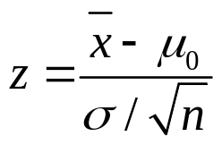
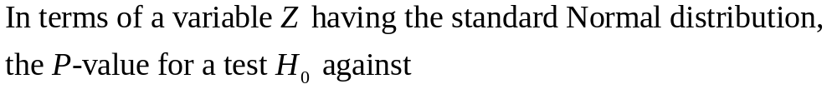
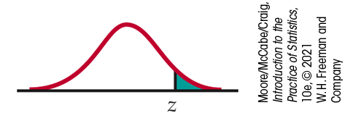

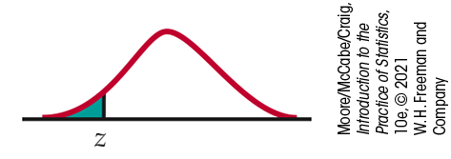

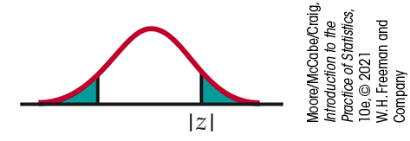

Tests for a Population Mean
Z Test for a Population Mean
Draw an SRS of size n from a Normal population that has unknown mean µ and known standard deviation σ. To test the null hypothesis that µ has a specific value,
Calculate the one-sample z statistic

Slide 31
Significance Test (1 of 2)
Example: Does the job satisfaction of assembly-line workers differ when their work is machine-paced rather than self-paced?
A matched pairs study was performed on a sample of workers, and each worker’s satisfaction was assessed after she or he worked in each setting. The response variable is the difference in satisfaction scores, self-paced minus machine-paced.
The null hypothesis is that, on average, there is no difference in scores in the population of assembly-line workers, while the alternative hypothesis (the one we would like to prove true) is that, on average, there is a difference in scores in the population of assembly workers.
H₀: μ = 0 H_{a}: μ ≠ 0
This is a two-sided alternative because we are interested in determining whether a difference, positive or negative, exists.

Slide 32
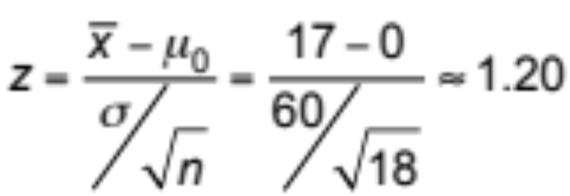
Significance Test (2 of 2)
Suppose job satisfaction scores follow a Normal distribution with standard deviation σ = 60. Data from 18 workers gave a sample mean score of 17. The test statistic is

Slide 33
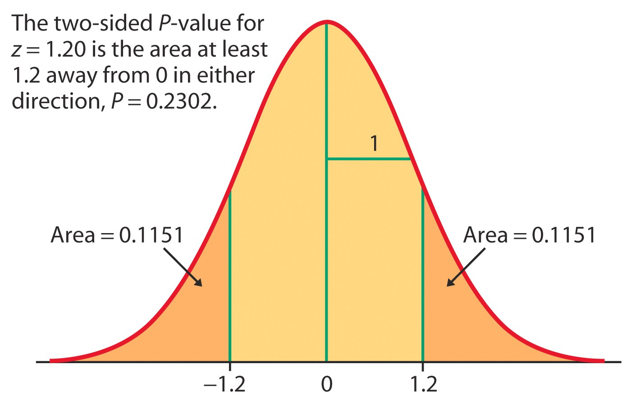
Significance Test
For the test statistic z = 1.20 and alternative hypothesis H_{a}: μ ≠ 0, the P-value would be
P-value = P(Z < –1.20 or Z > 1.20)
    = 2 P(Z < –1.20) = 2 P(Z > 1.20)
    = (2)(0.1151) = 0.2302
If H₀ is true, there is a chance of 0.2302 (23.02%) that we would see results at least as extreme as those in the sample. A probability of 0.2302 is not particularly small, and so the observed results are not unlikely if H₀ is true.
This means there is not strong evidence in favor of H_{a}.

Slide 34
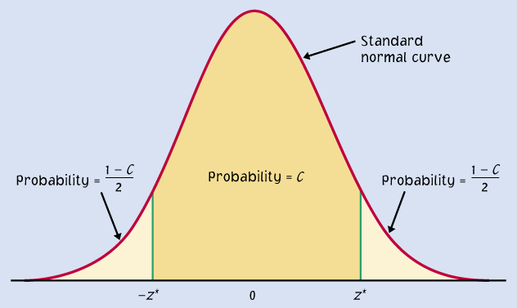
Two-Sided Significance Tests and Confidence Intervals
Because a two-sided test is symmetric, we can also use a 1 – α confidence interval to test a two-sided hypothesis at level α.
Confidence level C and α for a two-sided test are related as follows:
C = 1 – α
α/2
α/2

Slide 35
More about P-Values
A significance test can be done in a black-and-white manner: We reject H₀ if P < α; otherwise, we do not reject H₀.
Reporting the P-value is a better way to summarize a test than simply stating whether H₀ is rejected. This is because P quantifies how strong the evidence is against H₀. The smaller the value of P, the greater the evidence.
On the other hand, P does not provide specific information about the true population mean µ. If you desire a likely range of values for the parameter, use a confidence interval.
Statistics in practice use technology to get P-values quickly and accurately. In the absence of suitable technology, you can get approximate P-values by comparing your test statistic with critical values from a table. The example on the next slide shows how this works.

Slide 36
Approximating a P-Value
Suppose the hypotheses are
H₀: μ = 0 H_{a}: μ > 0
and the test statistic is z = –0.276. Because the alternative is “μ greater than 0,” the P-value is the area under the standard Normal density to the right of –0.276.
Table A gives areas to the left of specified z, or critical, values. Because of the symmetry of the Normal curve, the area to the right of –0.276 is equal to the area to the left of 0.276.
From Table A, the area to the left of 0.27 is 0.6064 and the area to the left of 0.28 is 0.6103. Because 0.276 is between 0.27 and 0.28, the P-value satisfies
0.6064 < P < 0.6103
There is no reason whatsoever to reject H₀ in this case; the P-value is very large.

Slide 37
6.3 Use and Abuse of Tests
Choosing a level of significance
What statistical significance does not mean
Do not ignore lack of significance
Potential importance of small effects
Beware of searching for significance

Slide 38
Cautions about Significance Tests 1
Choosing the significance level α
Factors often considered:
What are the consequences of rejecting the null hypothesis when it is actually true?
  What might happen if we concluded that global warming was real when it really wasn’t?
  Suppose an innocent person were convicted of a crime.
Are you conducting a preliminary study? If so, you may want a larger α so that you will be less likely to miss an interesting result.

Slide 39
Cautions about Significance Tests 2
Some conventions:
Typically, the standards of our field of work are used.
There are no sharp cutoffs for P-values: for example, there is no practical difference between 4.9% and 5.1%.
It is the order of magnitude of the P-value that matters:
“somewhat significant,” “significant,” or “very significant.”

Slide 40
Cautions about Significance Tests 3
What statistical significance does not mean:
Statistical significance indicates only whether the effect observed is likely to be due to chance alone because of random sampling.
Statistical significance may not be practically important. That’s because statistical significance does not tell you about the magnitude of the effect, only that there is one.
An effect could be too small to be relevant. And, with a large enough sample size, significance can be reached even for the tiniest effect.
  A drug is found to lower patient temperature an average of 0.4° Celsius (P-value < 0.01). But clinical benefits of temperature reduction appear only for a decrease of 1°Celsius or larger.

Slide 41
Cautions about Significance Tests 4
Do not ignore lack of significance.
  Consider this provocative title from the British Medical Journal: “Absence of evidence is not evidence of absence.”
  Having no proof that a particular suspect committed a murder does not imply that the suspect did not commit the murder.
Indeed, failing to find statistical significance in results means that “the null hypothesis is not rejected.” This is very different from actually accepting the null hypothesis. The sample size, for instance, could be too small to overcome large variability in the population.
In comparing two populations, lack of significance does not imply that the two populations are the same. The populations might be different but have similar statistical properties.

Slide 42
Cautions about Significance Tests 5
Potential importance of small effects
There is no consensus on how big an effect must be in order to be considered meaningful. In some cases, effects that may appear to be
trivial can be very important.
  Example: Improving the format of a computerized test reduces the average response time by about 2 seconds. Although this effect is small, it is important because this is done millions of times a year. The cumulative time saving of using the better format is gigantic.
Always think about the context. Try to plot your results and compare
them with a baseline or results from similar studies.

Slide 43
Cautions about Significance Tests 6
Beware of searching for significance.
You cannot legitimately test a hypothesis using data that first suggested that hypothesis.
When a large number of null hypotheses are tested simultaneously, it can be expected that several of the tests will show significance, even when all the null hypotheses are true.
The previous two points do not imply that exploratory data analysis is a bad thing. Exploratory analysis often leads to interesting discoveries. However, if the data at hand suggest an interesting theory, then test that theory on a new set of data!

Slide 44
6.4 Power and Inference as a Decision
Error probabilities and power
Increasing the power
The common practice of testing hypotheses

Slide 45
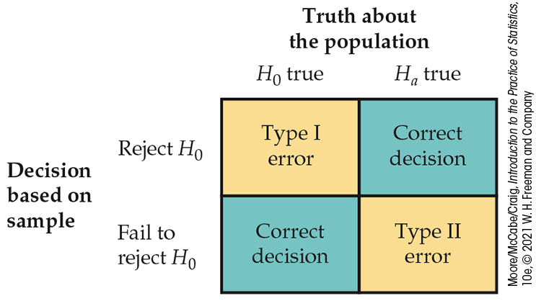
Power 1
When we draw a conclusion from a significance test, we hope our conclusion will be correct. But sometimes it will be wrong. There are two types of mistakes we can make.
If we reject H₀ when H₀ is true, we have committed a Type I error.
If we fail to reject H₀ when H₀ is false, we have committed a Type II error.

Slide 46
Power 2
The probability of a Type I error is the probability of rejecting H₀ when it really is true. This is exactly the significance level of the test.
The significance level α of any fixed-level test is the probability of a Type I error. That is, α is the probability that the test will reject the null hypothesis H₀ when H₀ is in fact true.
Consider the consequences of a Type I error before choosing a significance level.
A significance test makes a Type II error when it fails to reject a null hypothesis that really is false. There are many values of the parameter that satisfy the alternative hypothesis. We can calculate the probability that a test does reject H₀ when any specific alternative is true.
This probability is called the power of the test against that specific alternative.

Slide 47
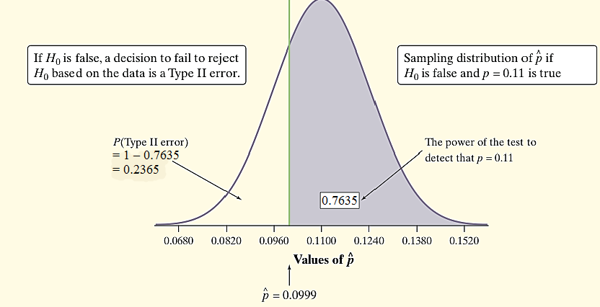
Power 3
Example: A potato chip producer wonders whether the significance test of H₀: p = 0.08 versus H_{a}: p > 0.08 based on a random sample of 500 potatoes has enough power to detect a shipment with, say, 11% blemished potatoes.
What if p = 0.11?
We would reject H₀ at α = 0.05 if our sample yielded a sample proportion to the right of the green line.
Power and Type II Error
Because we reject H₀ at α = 0.05 if our sample yields a proportion > 0.0999, we’d correctly reject the shipment about 76% of the time.
The power of a test against any alternative is 1 minus the probability of a Type II error for that alternative; that is, power = 1 – β.

Slide 48
Increasing the Power
Suppose we have performed a power calculation and found that the power is too small. There are four ways to increase power:
Increase the significance level α. It is more difficult to reject a null hypothesis with a larger α level.
Consider another value for μ that is farther from the null value. Values of μ that are farther from the hypothesized value are easier to detect.
Increase the sample size. More data will provide better information about the sample average, so we have a better chance of distinguishing values of μ.
Decrease σ. Improving the measuring process and restricting attention to a subpopulation are possible ways to decrease σ.

Slide 49
The Common Practice of Testing Hypotheses
State H₀ and H_{a} as in a test of significance.
Think of the problem as a decision problem, so the probabilities of Type I and Type II errors are relevant.
Consider only tests in which the probability of a Type I error is no greater than a specified α.
From among these tests, select a test that makes the probability of a Type II error as small as possible.

Slide 50
Chapter 6
Introduction to Inference (Review)
6.1 Estimating with Confidence
6.2 Tests of Significance
6.3 Use and Abuse of Tests
6.4 Power and Inference as a Decision

